Slide 1

Chapter 6: Object Modeling
Version 2 – 18th December 2015

Slide 2

Prescribed Text and recommended readings
Prescribed text
Rosenblatt, H. J. (2016), Systems Analysis and Design.11th Edition, Cengage Learning, Boston MA
Prescribed reading
Robertson, S. and Robertson, J. (2013), Mastering the Requirements Process: Getting Requirements Right, 3rd Edition, Addison Wesley, Upper Saddle River, NJ
IIBA (2015), Guide to the Business Analysis Body of Knowledge, BABOK Version 3.0, International Institute of Business Analysis, http://www.iiba.org/BABOKGuide.aspx

Slide 3
Learning Objectives
Explain how object-oriented analysis can be used to describe an information system
Define object modeling terms and concepts, including objects, attributes, methods, messages, classes, and instances
Explain relationships among objects and the concept of inheritance
Draw an object relationship diagram

Slide 4
Learning Objectives (cont.…)
Describe Unified Modeling Language (UML) tools and techniques including use cases, use case diagrams, class diagrams, sequence diagrams, state transition diagrams, and activity diagrams
Explain the advantages of using CASE tools in developing the object model
Explain how to organize an object model

Slide 5
Overview of Object-Oriented Analysis (Cont.1)
Object-Oriented Terms and Concepts
Unified modeling language (UML)
Method of visualizing and documenting an information system
Attributes: Characteristics that describe an object
Methods: Tasks or functions that the object performs
Message: Command to perform a specific function
A class is a group of similar objects
Instance: Specific member of a class

Slide 6
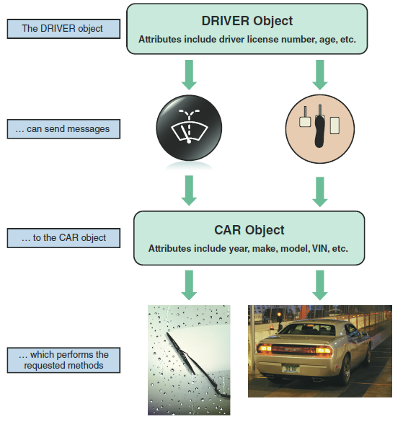
Overview of Object-Oriented Analysis (Cont.2)
Objects
Represented as a rectangle
The object name is at the top, followed by the object’s attributes and methods
FIGURE 6-1 Objects have attributes, can send and receive messages, and perform actions called methods.

Slide 7
Overview of Object-Oriented Analysis (Cont.3)
FIGURE 6-2 The PARENT object includes four attributes and two methods. Mary Smith, Ahmed Ali, and Anthony Greene are instances of the PARENT object.

Slide 8
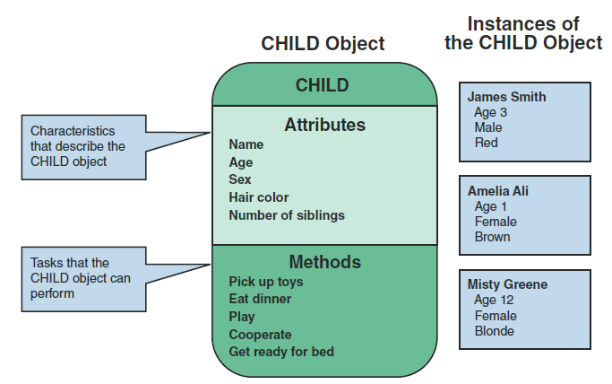
Overview of Object-Oriented Analysis (Cont.4)
FIGURE 6-3 The CHILD object includes five attributes and five methods. James Smith, Amelia Ali, and Misty Greene are instances of the CHILD object.

Slide 9
Overview of Object-Oriented Analysis (Cont.5)
Attributes
Describe the characteristics of an object
The number of attributes required depends on:
Business requirements of the information system
Requirements of users
Attributes of an object are defined during the system development process
Objects possess a state
State: Describes the object’s current status

Slide 10
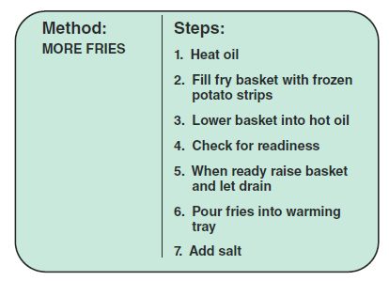
Overview of Object-Oriented Analysis (Cont.6)
Methods
Specific tasks that an object can perform
Identify functions performed
Describe the functions performed
FIGURE 6-4 The MORE FRIES method requires the server to perform seven specific steps.

Slide 11
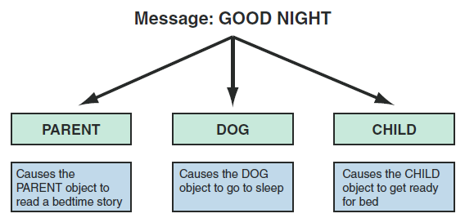
Overview of Object-Oriented Analysis (Cont.7)
Message
A command that tells an object to perform a certain method
Polymorphism: Concept that a message gives different meanings to different objects
FIGURE 6-5 In an example of polymorphism, the message GOOD NIGHT produces different results, depending on which object receives it.

Slide 12
Overview of Object-Oriented Analysis (Cont.8)
Message (cont.)
A message to the object triggers changes within the object without specifying how the changes must be carried out
An object can be viewed as black box
Encapsulation: Idea that all data and methods are self-contained, as in a black box
Figure 6-6 In a school information system, an INSTRUCTOR object sends an ENTER GRADE message to an instance of the STUDENT RECORD class.

Slide 13
Overview of Object-Oriented Analysis (Cont.9)
Classes
An object belongs to a group or category called a class
All objects within a class share common attributes and methods
Subclasses: Categories within a class
Super-class: A class belonging to a general category

Slide 14
Overview of Object-Oriented Analysis (Cont.10)
FIGURE 6-7 The VEHICLE class includes common attributes and methods. CAR, TRUCK, MINIVAN, and SCHOOL BUS are instances of the VEHICLE class.

Slide 15
Overview of Object-Oriented Analysis (Cont.11)
FIGURE 6-9 At the fitness center, the PERSON superclass includes common attributes and methods. EMPLOYEE is a class within the PERSON superclass. INSTRUCTOR is a subclass within the EMPLOYEE class.

Slide 16
Relationships Among Objects and Classes
Relationships
Enable objects to communicate and interact as they perform business functions and transactions
Describe what objects need to know about each other
Inheritance
The strongest relationship
Enables an object to derive one or more of its attributes from another object

Slide 17
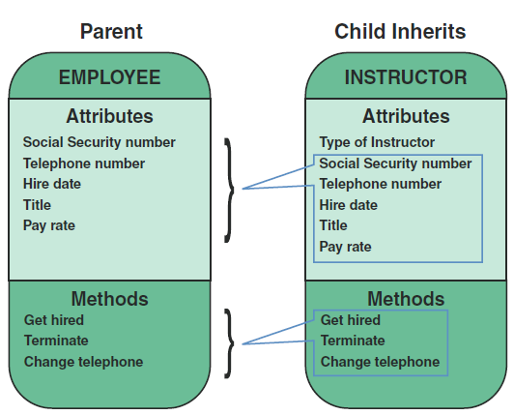
Relationships Among Objects and Classes (Cont.1)
FIGURE 6-10 An inheritance relationship exists between the INSTRUCTOR and EMPLOYEE objects. The INSTRUCTOR (child) object inherits characteristics from the EMPLOYEE (parent) class and can have additional attributes of its own.

Slide 18
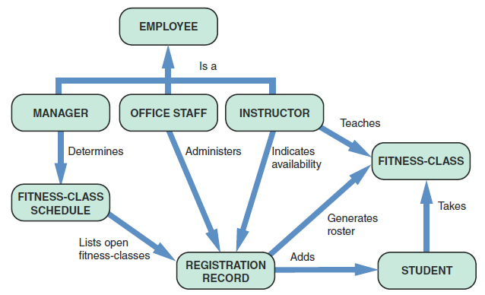
Relationships Among Objects and Classes (Cont.2)
Object Relationship Diagram
Displays objects and how they interact to perform business functions and transactions
FIGURE 6-11 Object relationship diagram for the fitness center.

Slide 19
Object Modeling with the Unified Modeling Language
UML uses a set of symbols to represent graphically the various components and relationships within a system
Use Case Modeling
Use case: Represents the steps in a specific business function or process
An external entity, called an actor, initiates a use case by requesting the system to perform a function or process

Slide 20
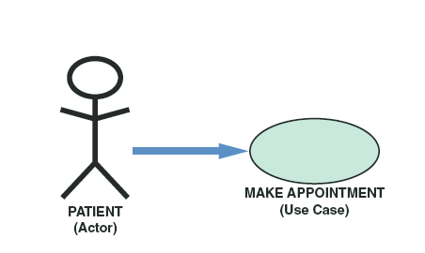
Object Modeling with the Unified Modeling Language (Cont.1)
Use Case Modeling (Cont.)
UML symbol for a use case is an oval with a label that describes the action or event
The actor is shown as a stick figure, with a label that identifies the actor’s role
Use case description: Documents the name of the use case, the actor, a description of the use case
Provides a step-by-step list of the tasks and other key descriptions and assumptions
FIGURE 6-12 In a medical office system, a PATIENT
(actor) can MAKE APPOINTMENT (use case).
Notes:
Use case description: Documents the name of the use case, the actor, a description of the use case, a step-by-step list of the tasks required for successful completion, and other key descriptions and assumptions

Slide 21
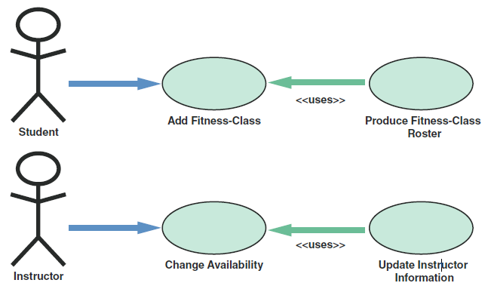
Object Modeling with the Unified Modeling Language (Cont.2)
FIGURE 6-13 When a student adds a class, PRODUCE FITNESS-CLASS ROSTER uses the results of ADD CLASS to generate a new class roster. When an instructor changes his or her availability, UPDATE INSTRUCTOR INFORMATION uses the CHANGE AVAILABILITY use case to update the instructor’s information.

Slide 22
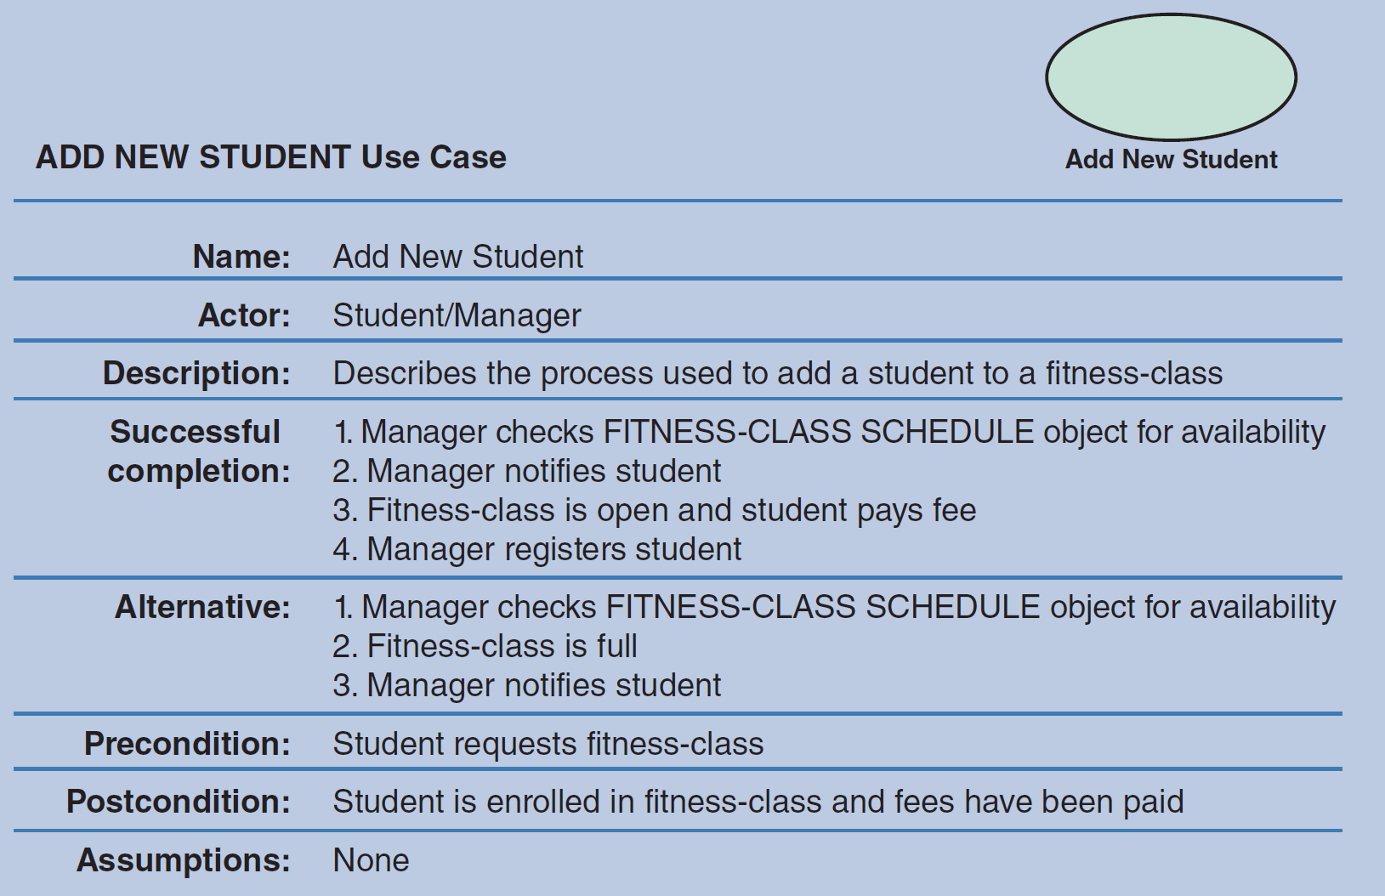
Object Modeling with the Unified Modeling Language (Cont.3)
FIGURE 6-14 The ADD NEW STUDENT use case description documents the process used to add a current student into an existing class.

Slide 23
Object Modeling with the Unified Modeling Language (Cont.4)
Use Case Diagrams
A visual summary of several related use cases within a system or subsystem
The first step is to identify the system boundary which is represented by a rectangle
System boundary: Shows what is included in the system (inside the rectangle) and what is not included in the system (outside the rectangle)

Slide 24
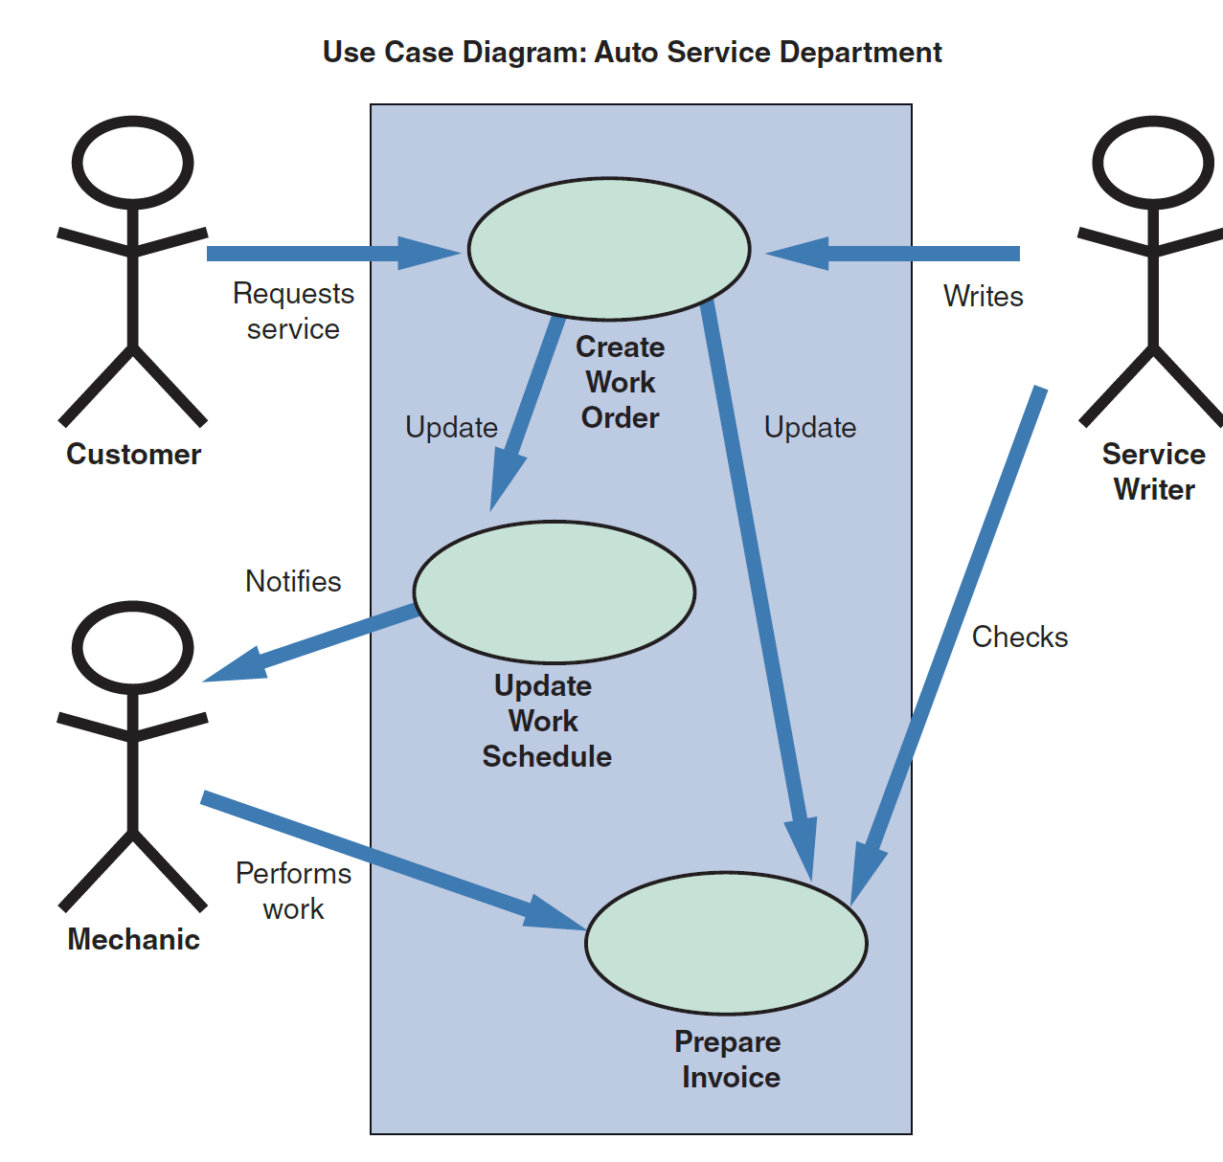
Object Modeling with the Unified Modeling Language (Cont.5)
FIGURE 6-16 A use case diagram to handle work at an auto service department.

Slide 25
Object Modeling with the Unified Modeling Language (Cont.6)
Class Diagrams
Show the object classes and relationships involved in a use case
Each class appears as a rectangle, with the class name at the top, followed by the class’s attributes and methods
Lines show relationships between classes and have labels identifying the action that relates the two classes
Includes a concept called cardinality
Cardinality: Describes how instances of one class relate to instances of another class

Slide 26
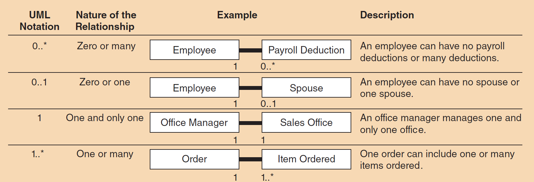
Object Modeling with the Unified Modeling Language (Cont.7)
FIGURE 6-17 Examples of UML notations that indicate the nature of the relationship between instances of one class and instances of another class.

Slide 27
Object Modeling with the Unified Modeling Language (Cont.8)
FIGURE 6-18 Class diagram for a sales order use case (attributes and methods omitted for clarity).

Slide 28
Object Modeling with the Unified Modeling Language (Cont.9)
Sequence Diagrams
Dynamic model of a use case, showing the interaction among classes during a specified time period
Graphically document the use case by showing the classes, the messages, and the timing of the messages
Include symbols that represent classes, lifelines, messages, and focuses

Slide 29
Object Modeling with the Unified Modeling Language (Cont.10)
Sequence Diagrams (Cont.)
Classes
Send or receive messages
Shown at the top of the sequence diagram
Lifelines
Represent the time during which the object above it is able to interact with the other objects in the use case
An X marks the end of the lifeline
Messages
Include additional information about the contents
Focuses
Indicate when an object sends or receives message

Slide 30
Object Modeling with the Unified Modeling Language (Cont.11)
FIGURE 6-19 A sequence diagram with two classes. Notice the X that indicates the end of the CLASS 2 lifeline. Also notice that each message is represented by a line with a label that describes the message, and that each class has a focus that shows the period when messages are sent or received

Slide 31
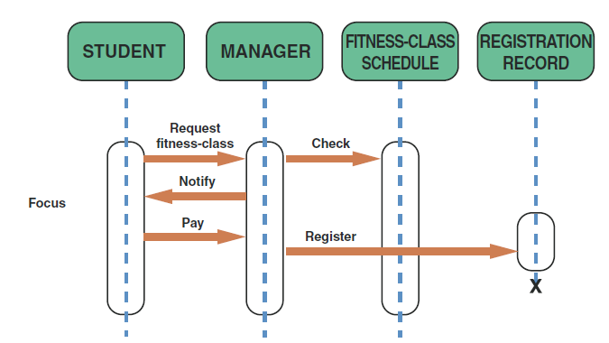
Object Modeling with the Unified Modeling Language (Cont.12)
FIGURE 6-20 The sequence diagram for the ADD NEW STUDENT use case. The use case description for ADD NEW STUDENT is shown in Figure 6 14.

Slide 32
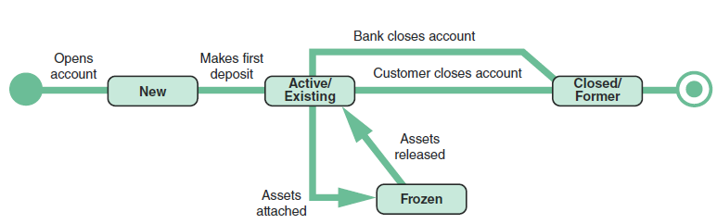
Object Modeling with the Unified Modeling Language (Cont.13)
State Transition Diagrams
Show how an object changes from one state to another, depending on events that affect the object
All possible states must be documented in the state transition diagram
States appear as rounded rectangles with the state names inside
FIGURE 6-21 An example of a state transition diagram for a bank account.

Slide 33
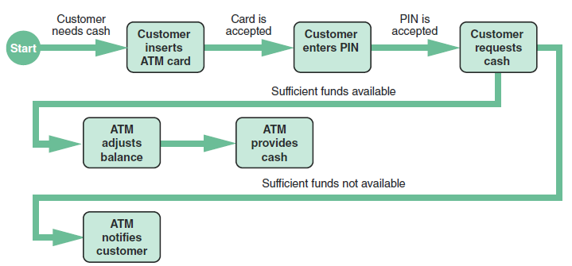
Object Modeling with the Unified Modeling Language (Cont.14)
Activity Diagrams
Show actions and events as they occur
Show the order in which the actions take place and identify the outcomes
FIGURE 6-22 An activity diagram shows the actions and events involved in withdrawing cash from an ATM.

Slide 34
Object Modeling with the Unified Modeling Language (Cont.15)
Business Process Modeling (BPM)
Represents the people, events, and interaction in a system
Can be used anytime during the systems development process
Compatible with object modeling

Slide 35
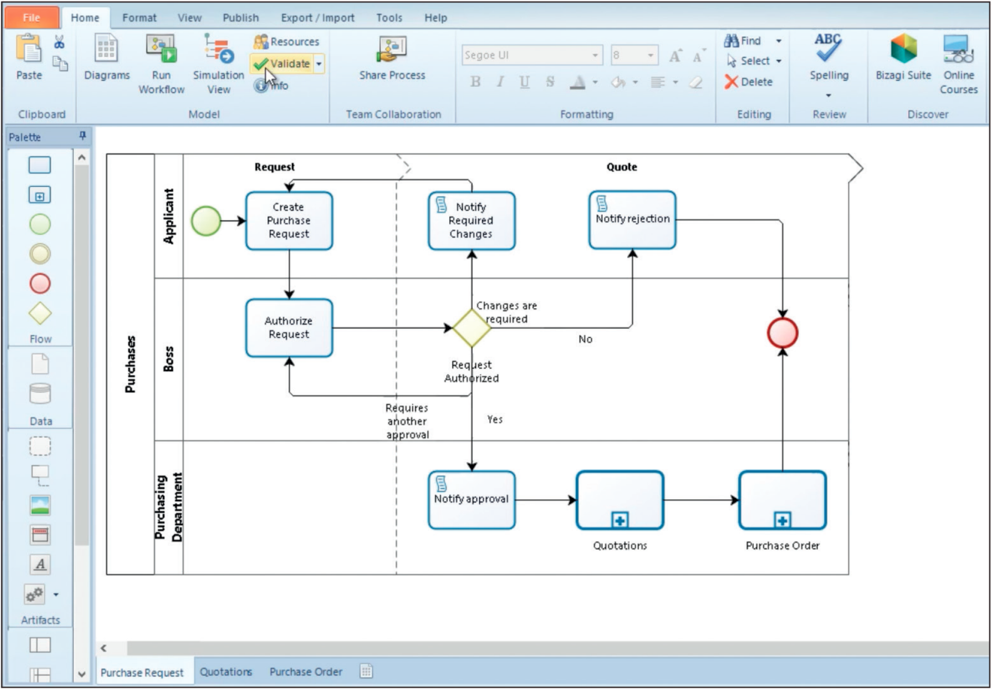
Object Modeling with the Unified Modeling Language (Cont.16)
FIGURE 6-23 The Bizagi Modeler tool supports business modeling and simulation using the standard BPM notation.
Source: bizagi.com

Slide 36
Object Modeling with the Unified Modeling Language (Cont.)
CASE Tools
Provide an overall framework for documenting the system components
Object modeling requires many types of diagrams to represent proposed systems
CASE tools speed up the process
Ensure consistency and provide common links
Once objects are described and used in one part of the design, they can be reused multiple times without further effort

Slide 37
Organizing the Object Model
Develop an object relationship diagram that provides an overview of the system
Support each diagram or object definition with clear and relevant documentation that can be accessed easily
Organize use cases and use case diagrams so they can be linked to the appropriate class, state transition, sequence, and activity diagrams
Maintain accuracy

Slide 38
Chapter Summary
Object modeling is a popular technique that describes a system in terms of objects
Object-oriented terms include classes, attributes, instances, messages, and methods
Objects can send messages, or commands, that require other objects to perform certain methods, or tasks

Slide 39
Chapter Summary (Cont.)
The Unified Modeling Language (UML) is a widely used method of visualizing and documenting an information system
Use case describes a business situation initiated by an actor, who interacts with the information system
At the end of the object modeling process, the use cases and use case diagrams are organized and class, sequence, state transition, and activity diagrams are created

Slide 40

kent.edu.au Kent Institute Australia Pty. Ltd. ABN 49 003 577 302 ● CRICOS Code: 00161E ● RTO Code: 90458 ● TEQSA Provider Number: PRV12051

